Slide 1
The New ABCs: Ambiguity Blockchain Crypto
May 2022

Slide 2
Agenda
Landscape of ABC’s
How a transaction works
Flavors of crypto
Key terms of Crypto
Regulatory Environment
PNC Internal

Slide 3
Executive Summary
Rapid Change & Volatility
Capital
Record VC fundraising in 2021
IPO of Coinbase
No Winners Yet
Unknown Regulatory Environment
PNC Internal

Slide 4
Market Growth & Investment
Cryptocurrency Market
Historical Price Chart – BTC and ETH
Top 15 Cryptocurrencies by Market Cap (“Coins”; $bn)
Layer-1 Protocol
Layer-0 Protocol
Other
Stablecoin
Source: Yahoo! Finance, coinmarketcap.com
As of 5/17/2022.
PNC Internal

Slide 5
Evolving Consumer Opinions
80% would move their digital assets to their bank if possible
66% of non-crypto investors cite lack of trust / knowledge as the main obstacle
60% of digital asset holders are under 45 years old
Perception of Digital Assets
Interest in bitcoin Purchases
Interest has grown across all age ranges since 2017
PNC Internal Sources: DeFi Pulse, EY- Parthenon

Slide 6
Overview & Foundation
Key Terminology
Term | Definition | Similar To
Blockchain | Technology enabling everyone involved in a transaction to know with certainty what happened, when it happened and confirm other parties are seeing the same thing without the need for an intermediary providing assurance, and without a need to reconcile data afterwards | Cloud database or network
Cryptocurrency | A currency that exists digitally and uses cryptography to secure transactions is the structure storing transactional records across several databases | Digital money or investment
Distributed Ledger | Decentralized database managed by multiple participants across multiple nodes | Database in the sky
Web3 | Idea for a new iteration of the World Wide Web based on blockchain technology, which incorporate concepts such as decentralization and token-based economics | Next big thing – like social media was
Non-Fungible Token (“NFT”) | Non-interchangeable unit of data stored on a blockchain that can be sold and traded. Types of NFT data units may be associated with digital files such as photos, videos and audio | Indisputable certificate of ownership
Decentralization | The blockchain is decentralized, so there isn’t a need for a central, certifying authority | Like Uber to Taxi companies
Wallet | Device, program or a service which stores the public and / or private keys for cryptocurrency transactions. In addition to this basic function of storing the keys, a cryptocurrency wallet more often also offers the functionality of encrypting and / or signing information | Account
Public Key | Allows you to receive cryptocurrency transactions. It’s a cryptographic code that’s paired to a private key. While anyone can send transactions to the public key, you need the private key to “unlock” them and prove that you are the owner of the cryptocurrency received in the transaction | Account number
Private Key | Gives you the ability to prove ownership or spend the funds associated with your public address | Account password
PNC Internal

Slide 7
Overview & Foundation
Digital Asset Financial System Comparison
 | Simple Terms | Traditional | Utilizing Digital Assets
Transactions & Payment Services | Buy, sell and store digital assets | Utilizing a mobile / desktop application to transfer money between bank accounts or peer to peer | Utilize apps like Blockchain to make transactions, view portfolio and store
Exchange, Trading & Yield | Exchange digital assets between different platforms | Using the New York Stock Exchange to make security transactions | Utilizing Coinbase, Opensea or digital crypto exchanges
Identity, Authentication & Security | Digital Ledger software in which assets, transactions and users can be verified | Store information in password protected browser | Use encrypted private keys, including multi-party signing for security
Enterprise Blockchain Solutions | Utilizing blockchains to provide solutions to various industries; transition from the cloud to blockchain | Utilizing software to provide audit functions, applications or databases | Utilize blockchain to store information in private key securely
Social, Games & Metaverse | Utilizing Web3 for unregulated / monitored activity | Utilizing social media to connect with friends | Connecting via Metaverse in virtual reality
Ecosystem | Mine, manage and create digital assets | Users have multiple interfaces for one functionality | Utilize blockchain as single location to complete tasks

Slide 8
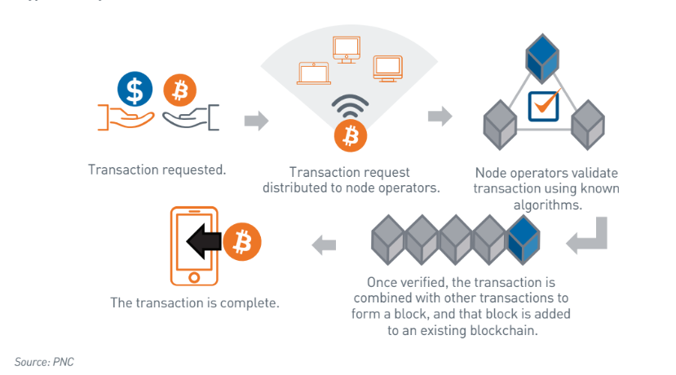
How blockchain works for cryptocurrency
Illustration
PNC Internal

Slide 9
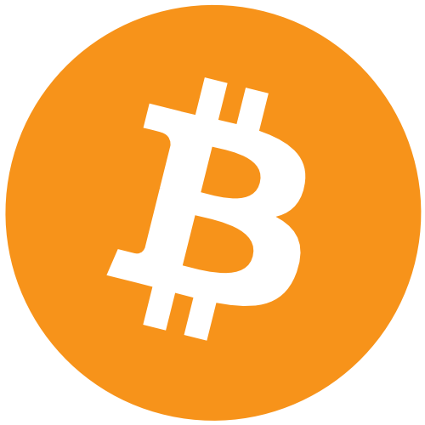
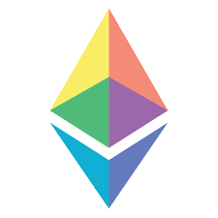
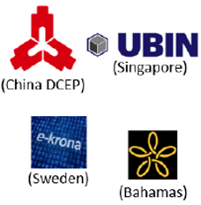
Many Kinds of Digital Assets
Based on blockchain technology
Digital Assets
Stablecoins
Other Tokens
Cryptocurrencies
Public / CBDCs
Private
Utility
Asset-Backed
Native asset of specific blockchain
Digital version of cash, denominated in national unit of the account and direct liability of central bank
Digital money whose price is pegged to existing fiat currency, a basket of currencies or assets, a cryptocurrency or to an exchange-traded commodity
Security token, Non-fungible token (NFT)
Access to a given product or service
Could be used to raised capital
Not designed to be an investment / speculation, but speculation occurs
Source:Celent Reports and Insights
PNC Internal

Slide 10
Overview & Foundation
Digital Asset Financial System Comparison
 | Traditional Finance (TradFi) | Centralized Finance (CeFi) | Decentralized Finance (DeFi)
Who | Mainstream regulated financial services | Centralized platforms that bridge TradFi and the digital asset players | Decentralized platforms and protocols that provide a variety of services, integral part of Web3
Products | Custodial accounts | Custodial wallets (Core service tends to be holding / trading digital assets, including fiat-to-crypto) | Non-custodial wallets
 |  | Connectivity with non-custodial accounts (DeFi wallets) | Decentralized with peer-to-peer trading of digital assets
Examples | PNC Bank, Bank of America, Discover, Goldman Sachs, PayPal, and Wells Fargo | Holding / trading: Binance, Coinbase and Kraken | Trading: Pancakeswap, Sushiswap, Uniswap Wallets: ConsenSys, MetaMask2
 |  | Paying: Circle, Ripple, Wyre | Paying: Lightning
 |  |  | Lending / borrowing: Aave, Compound, Maker
PNC Internal

Slide 11
U.S. Regulatory Policies Have Been Evolving
…for a while…
Themes: Consumer Protection, Compliance (AML / sanctions), and System Stability
2014
2015
2016
2017
2018
2019
2020
2021
2022
Mar: IRS declared virtual currency will be taxed as property
Mar: CA passed AB 1326, which would explicitly bring bitcoin companies under licensing guidelines
Feb: SEC chairman emphasizes concern for secondary market trading potential of the tokens offered for sale
Jun: Director of SEC emphasized sale of digital asset not always be security
Mar: SEC creates FinHub to research digital asset and properly classify them
Jun: SEC and FINRA issue a joint statement to outline considerations for digital asset securities custody
Mar: U.S. executive order calls on the government to examine cryptocurrency
Mar: SEC accounting bulletin to, essentially, carry reserves on balance sheet for assets in custody
May: FinCEN announced first round of Bank Secretary audits of companies registered as money transmitters in digital currency
Sept: CFTC announces first civil enforcement action against Coinflip
Mar: SEC creates FinHub to research digital asset and properly classify them
Jun: SEC and FINRA issue a joint statement to outline considerations for digital asset securities custody
Jul: SEC issues report considering the DAO was a security
Dec: SEC issues an order institution cease-and-desist to halt sale of tokens (Munchee Order)
Feb: SEC issues Risk Alert regarding digital assets
Nov: OCC guidance requiring banks to seek supervisory non-objection prior to launching crypto products
Nov: President’s working group recommends stablecoin issuers behave like banks with regulators and deposit insurance

Slide 12
Overview & Foundation
March 2022 Executive Order
On 3/11/2022, President Biden issued an executive order that puts a plan in place to further understand the developing digital asset space. President Biden is calling on several agencies to provide information to the Administration within the next 6 months. This information will be used so the U.S. can remain competitive globally in the digital landscape
Protect U.S. Consumers, Investors & Businesses
Promote Equitable Access to Safe & Affordable Financial Services
Directing the Department of the Treasury and other partners to develop recommendations to address the implications of the digital asset sector
Encourage regulators to ensure sufficient oversight and safeguard against any systemic financial risks posed by digital assets
The Secretary of the Treasury will produce a report on the future of money and payment systems, to include implications for economic growth, financial growth and inclusion, national security and the extent to which technological innovation may influence that future
Safe access is important for communities that have long had insufficient access to financial services
Protect U.S. / Global Financial Stability & Mitigate Risk
Encourage the Financial Stability Oversight Council to identify and mitigate systemic financial risks posed by digital assets
Develop appropriate policy recommendations to address any regulatory gaps
Support Technological Advances & Ensure Responsible Development / Use
Direct the U.S. Government to take concrete steps to study and support technological advances in the responsible development, design, and implementation of digital asset systems while prioritizing privacy, security, combating illicit exploitation, and reducing negative climate impacts
Mitigate Illicit Finance & National Security Risk
Direct a focus of coordinated action across all relevant U.S. Government agencies to mitigate XYZ risks
Direct agencies to work with our partners to ensure international frameworks, capabilities and partnerships are aligned and responsive to risks
Explore a U.S. Central Bank Digital Currency (CBDC)
Direct the U.S. Government to assess the technological infrastructure and capacity needs for a potential U.S. CBDC in a manner that protects Americans’ interests
Encourage the Fed to continue its research, development, and assessment efforts for a U.S. CBDC, including development of a plan for broader U.S. Government action in support of their work
Prioritize U.S. participation in multi-country experimentation, and ensures U.S. leadership internationally to promote CBDC development that is consistent with U.S. priorities
Promote U.S. Leadership in Technology / Economic Competitiveness
Direct the Department of Commerce to work across the U.S. Government in establishing a framework to drive U.S. competitiveness and leadership in, and leveraging of digital asset technologies
This framework will serve as a foundation and integrate this as a priority into their policy, research and development and operational approaches to digital assets

Slide 13
Questions

